Slide 1
Uncover Security Design Flaws with STRIDE
Dr Md Sadek Ferdous
COMP6236 - Software Engineering and Cyber Security

Slide 2


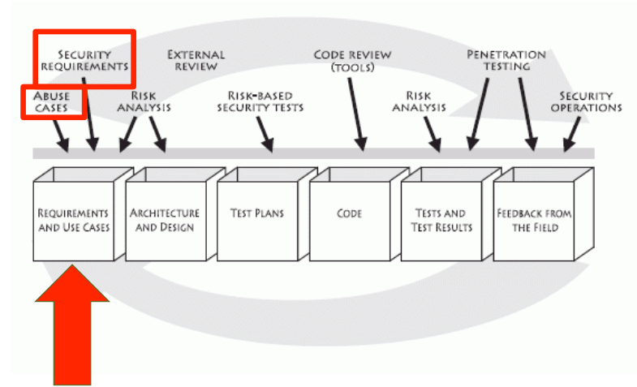
Last
Week
25/10/16
2

Slide 3
Security Goals vs Requirements
•
•
A security goal protects
Type of security goals
– Confidentiality
– Integrity
– Availability
– Accountability
an
asset
from
harm
•
A security requirement
is a constraint over a functional
requirement that operationalizes a security goal
25/10/16
3

Slide 4
Security Goals vs Requirements
•
Functional requirement
– System must provide a function to retrieve personnel
Threat scenario
– Snoopy employee checks colleague’s paycheck
Security goal
– Protect personnel info from confidentiality harm
Security requirement
– Only HR people can use the above functionality
info
•
•
•
25/10/16
4

Slide 5
A
Chess
Game
develops
Security
team
develops
Misuse
Cases
Security
Use cases
drive
analyse and specify
analyse and specify
Assets and
Services
are
vulnerable
to
Security
Threats
Security
Requirements
Security
Mechanisms
necessitate
require
counter
protect
25/10/16
5

Slide 6
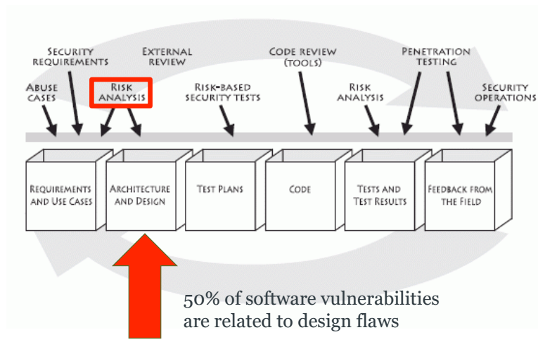
Today
25/10/16
6

Slide 7
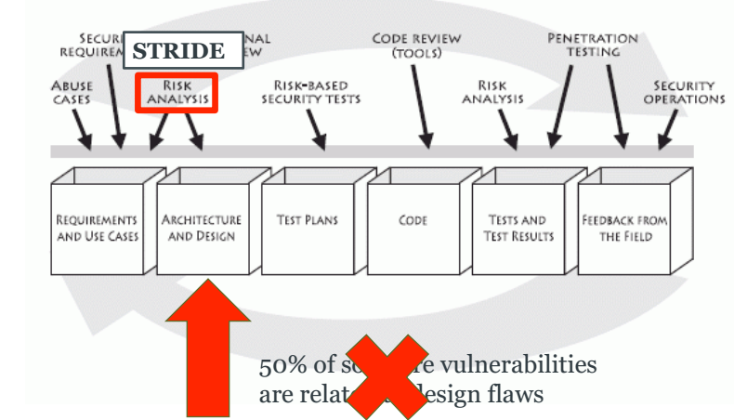
Today
25/10/16
7

Slide 8
Learning outcomes
•
By the end of today’s lecture you should be able to:
– Identify and list threats that apply to software
components
– Assess the risk represented by threats
design
– Identify
and
list
mitigations
for
those
threats
25/10/16
8

Slide 9
Threat Modeling
•
Activity that occurs early in the software development
lifecycle
•
Main goal is to identify security design issues before
committed
code
is
•
Threat modeling can be done on various levels of
abstraction
– System level e.g Internet e-mail system
– Application or component level e.g e-mail client software
25/10/16
9

Slide 10
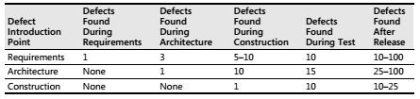
Threat Modeling
25/10/16
10

Slide 11
Threat Modeling
Define use scenarios.
Gather a list of external dependencies.
Define security assumptions.
Create external security notes.
Create one or more DFDs of the application being modelled.
Determine threat types.
Identify the threats to the system.
Determine risk.
Plan mitigations
25/10/16
11

Slide 12
Threat Modeling
Define use scenarios.
Gather a list of external dependencies.
Define security assumptions.
Create external security notes.
Create one or more DFDs of the application being modelled.
Determine threat types.
Identify the threats to the system.
Determine risk.
Plan mitigations
25/10/16
12

Slide 13
Define use scenarios
Not the use-case scenario of the software
Determine which key threat scenarios are within scope
e.g. if the software to be used in a mobile, consider the stolen-mobile device scenario
What happens to the data when the device gets stolen?
Don’t forget the insider-threat scenario
Also include other common, but not security-related, scenarios:
e.g. the type of customer expected to use the software
25/10/16
13

Slide 14
Gather a list of external dependencies
Consider and document each external dependencies
Which OS it will be installed on?
If a web application, which web-server it will be deployed on?
Will it use any DB? If so, which DB is preferred?
Which high-level application framework it uses?
Which external API and/or code it utilises?
25/10/16
14

Slide 15
Define security assumptions
Inaccurate security assumptions might make an application utterly insecure
regarding external dependencies as well the software components
Example: storing encryption key
storing at the system?
how to protect unauthorised access?
25/10/16
15

Slide 16
Create External Security Notes
Notes regarding security for users and other application designers
To be used during their interaction with the product
Help them to understand:
application’s security boundaries and
how they can maintain security when using your application
25/10/16
16

Slide 17
Threat Modeling
Create one or more DFDs of the application being modelled.
Determine threat types.
Identify the threats to the system.
Determine risk.
Plan mitigations
STRIDE
25/10/16
17

Slide 18
STRIDE
•
•
•
Popular threat modeling technique by Microsoft
Focus on what an attacker is trying to achieve
Endorsed by Security Touchpoints, OWASP’s
Microsoft’s SDL
CLASP
and
•
•
•
Taught in security certification programs
like
CSSLP
Widely used in industry
Require little security expertise
25/10/16
18

Slide 19
STRIDE
Spoofing Identity
Tampering
Repudiation
Information Disclosure
Denial of Service
Elevation of Privilege
25/10/16
19

Slide 20
STRIDE Process
1.
2.
Create Data Flow Diagrams (DFDs)
Identify the Threats
1.
2.
Map STRIDE to DFD Element Types
Refine threats
via
threat
tree
patterns
3.
4.
Determine risk
Plan mitigations
25/10/16
20

Slide 21
Create Data Flow Diagrams
•
A DFD is a graphical representation of the system under
review
– Model how data enters, leaves and traverses software components
– Shows all data sources and destinations
– Shows all relevant processes that the data goes through
Good DFDs are critical to threat modeling!!
•
25/10/16
21

Slide 22
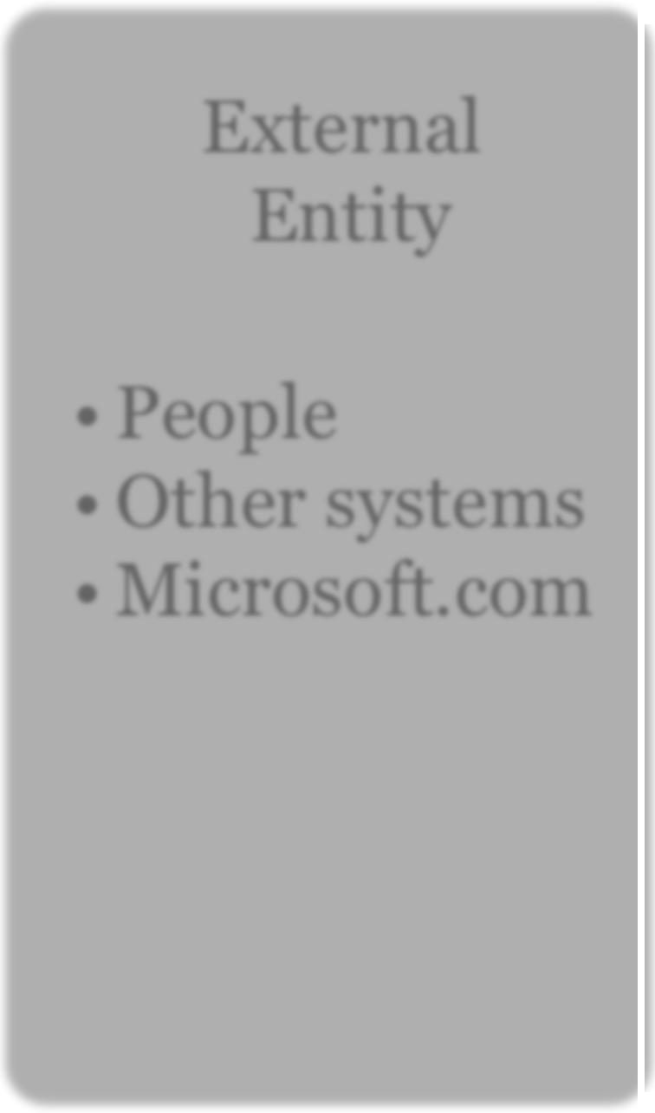
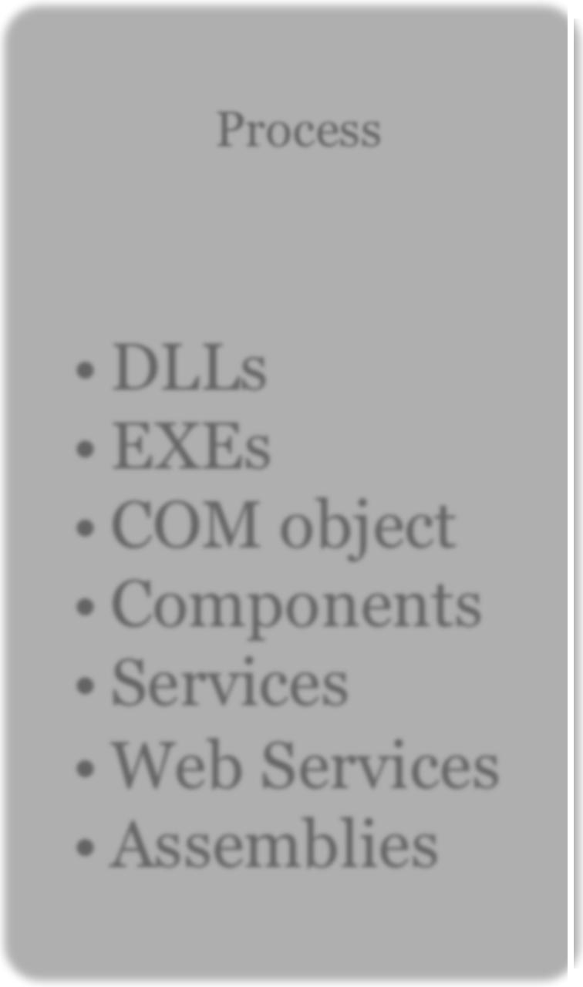
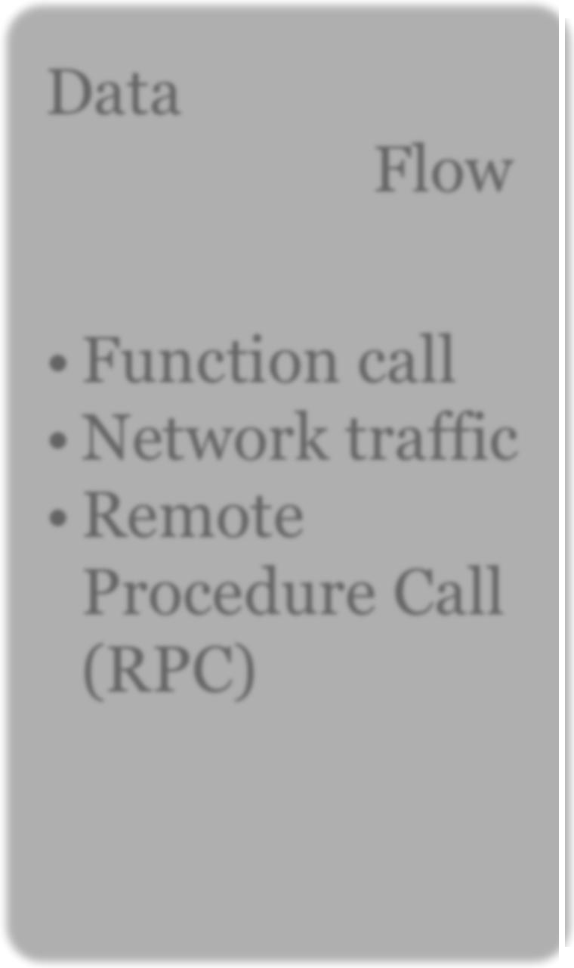
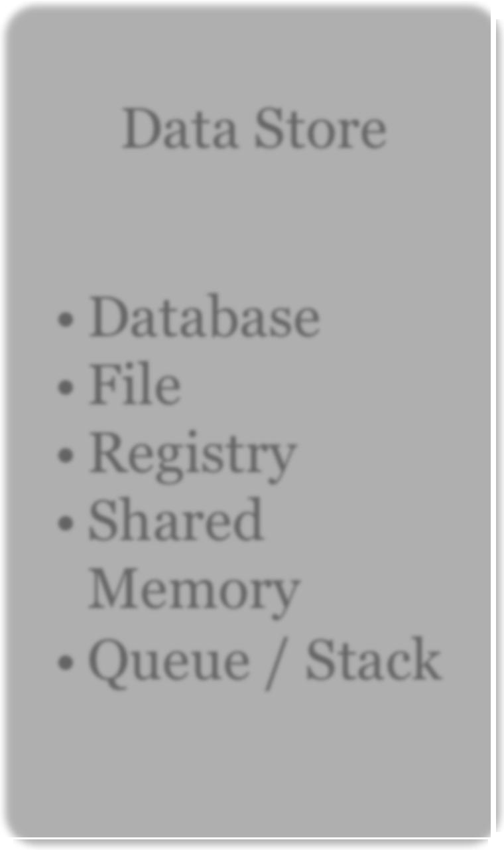
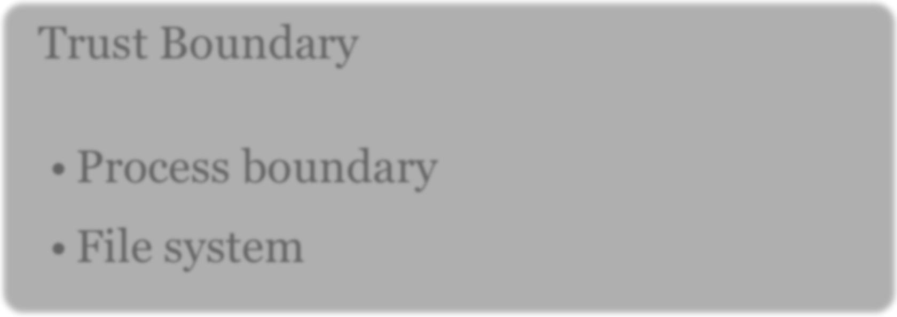
Diagram
Elements
External
Entity
Process
Data
Flow
Data Store
• People
• Other systems
• Microsoft.com
• DLLs
• EXEs
• COM object
• Components
• Services
• Web Services
• Assemblies
• Function call
• Network traffic
• Remote Procedure Call (RPC)
• Database
• File
• Registry
• Shared
Memory
• Queue / Stack
Trust Boundary
• Process boundary
• File system
25/10/16
22

Slide 23
DFD
Example
Process
PIN
1 Customer
2
Enquiries
Account info
Account info
(read)
External entity
Data Flow
3 Account details
25/10/16
Data Store
23

Slide 24
DFDs Decomposition
•
Iterate over processes, data stores, and see where they
need to be broken down
•
Initially draw a context diagram
– Very high-level; software and external entities interacting with it
Then, draw a level 1 diagram
– High level; major business processes
Then processes can be further decomposed in level 2
diagrams
•
•
•
And so on till no further decomposition is possible
25/10/16
24

Slide 25
Pet
Shop
Context
Diagram
View files and
logging data
Request
Petshop Customer (1.0)
PetShop
(4.0)
Admin
(3.0)
Response
Apply settings
Request
Response
Anonymous
User (2.0)
25/10/16
25

Slide 26
Pet
Shop
Level 1
Diagram
Create, Read,
Update
1
Web App Config 4.1
Create,
Update
Read
Crea
User
Profile
4.5
te,
Update
Read
User Profile Data 4.8
Anon
Users (2.0)
Create, R
Request
1
ead,
Update & Delete
Response
Create,
Update
Web App
4.2
Member-
Ship
4.6
Create,
Update
Admin
3.0
Request
Read
1
Read
PetShop
Customer (1.0)
Response
Membership Data 4.9
Read
Create
Updat
Read
1
Create, Read,
Update & Delete
,
Update
Ordering
4.7
Web Pages 4.3
1
Create, Read, Update & Delete
25/10/16
27

Slide 27
Pet
Shop Level 2
Diagram
Audit Log 4.7.10
1
Write
audit entry
Create, Read,
Delete (purge)
Orders 4.7.6
1
Create, Read,
Update, Delete
Create, Read,
Logging
Engine
4.7.9
Update
Synch
Order
4.7.2
Place order
Data
Access
4.7.4
Create
audit entry
Place order
Get order status
or confirmation
Read,
Order
Processor
4.7.1
Get order status
or confirmation
Update
Admin
3.0
1
Read
Place order
Inventory 4.7.7
1
Create, Read,
Update, Delete
Web app 4.2
Create,
Update
Get order status
or confirmation
Place order
Asynch
Order
4.7.3
Queuing
4.7.5
Get order status
or confirmation
Create, Read,
Update, Delete
1
Asynch Orders 4.7.8
25/10/16
26

Slide 28

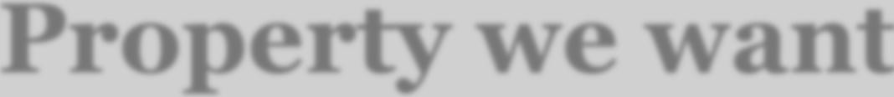
Identify Threats
•
Use STRIDE
taxonomy
of
threats
Threat
Spoofing
Tampering
Repudiation
Information Disclosure
Denial of Service
Elevation of Privilege
Property we want
Authentication Integrity Nonrepudiation Confidentiality Availability Authorization
25/10/16
28

Slide 29
Threat:
Threat
Security
Goal
Spoofing
Spoofing
Authentication
Definition
Impersonating
something
or
someone
Phishing
else
Example
25/10/16
29

Slide 30


Threat:
Threat
Security
Goal
Tampering
Tampering
Integrity
Definition
Example
Modifying data
or code
Modifying a DLL on disk or DVD,
a packet as it traverses the LAN
or
25/10/16
30

Slide 31
Threat:
Threat
Security
Goal
Repudiation
Repudiation
Non-Repudiation
Definition
Claiming to have not
an action
performed
Example
“I didn’t send that email,” “I didn’t
modify that file,” “I certainly didn’t
visit that Web site, dear!”
25/10/16
31

Slide 32
Threat:
Threat
Security
Goal
Information Disclosure
Information Disclosure
Confidentiality
Definition
Exposing information to
not authorized to see it
someone
Example
Allowing someone to read the
Windows source code; publishing a
list of customers to a Web site
25/10/16
32

Slide 33
Threat:
Threat
Security
Goal
Denial of Service
Denial of Service
Availability
Definition
Example
Deny or degrade service to
users
Crashing Windows or a Web site,
sending a packet and absorbing
seconds of CPU time, or routing
packets into a black hole
25/10/16
33

Slide 34
Threat:
Threat
Security
Goal
Elevation of Privilege
Elevation of Privilege (EoP) Authorization
Definition
Gain capabilities without proper
authorization
Allowing a remote Internet user to
run commands is the classic
example, but going from a “Limited
User” to “Admin” is also EoP
Example
25/10/16
34

Slide 35
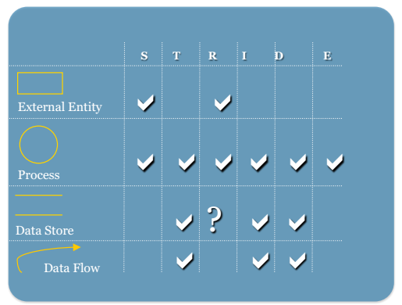
Map
STRIDE
to DFD Element
Types
S
T
R
I
D
E
!
!
External Entity
! !!! !!
Process
! ?
!
!!
!!
Data Store
Data Flow
25/10/16
35

Slide 36
Map
STRIDE
to
DFD
Elements
Threat Type DFD Elements
Spoofing External Entities: Pet Shop Customer…
Processes: Web application, Order processor
Tampering Processes: Web application, Order processor
Data stores: Audit-log data,…
Data Flows: Pet Shop Customer to Web application,….
Repudiation External Entities: Pet Shop Customer…
Information Disclosure Data stores: Audit-log data,…
Data Flows: Pet Shop Customer to Web application,…
Denial of Service Data stores: Audit-log data,…
Data Flows: Pet Shop Customer to Web application,….
Elevation of Privileges Processes: Web application, Order processor
25/10/16
36

Slide 37
Refine threats with threat
tree patterns
•
Generic threat types are refined into concrete
trees
threats
via
•
•
AND/OR composition of threats
STRIDE provides 12 at threat tree
patterns
–
–
–
–
–
–
1 threat three for Spoofing
3 threat threes for Tampering
1 threat three for Repudiation
3 threat threes for Information Disclosure
3 threat threes for Denial of Service
1 threat three for Elevation of Privileges
25/10/16
37

Slide 38
Threat tree
pattern examples
Information
disclosure
of
data flows
and
Observe
message
Observe
channel
Side
channel
No message
confidentiality
Weak message
confidentiality
MITM
No channel
confidentiality
25/10/16
38

Slide 39
Threat
tree
pattern
examples
Tampering
with
data store
Bypass
protection
Bypass
monitor
Over-
capacity
scheme
failures
Weak
protection
No
protection
No
monitor
Bypass
monitor
Discard
Other
failure mode
Canonicalization
failure
Wraparound
Tampering
with
monitor
process
EoP against
monitor
process
Extra-monitor
access
25/10/16
39

Slide 40
Threat tree
pattern examples
Elevation
of privilege,
process
Spoofing
an
authorized
external
entity
Dynamic
corruption
Static
corruption
Leverage
insufficient
authorization
Input validation
failure
Access to
memory
Cross-domain
issues
Call-chain
issues
Tampering
with
data store
25/10/16
40

Slide 41
Refining
threats
DFD Threat Type Threat
Element
Pet Shop Information Disclosure (I) Observe message – No Message
Customer to Confidentiality
Web application
Audit Log Data Tampering (T) Tampering with Data Store – Store Weak Protection
Order Elevation of Privileges (EoP) Leverage Insufficient
Processor ^{Authorization}
25/10/16
41

Slide 42
Assess the Risks
•
Risk level given by the combination
impact
of likelihood and
•
4 Possible Risk Levels
– 1
– 2
– 3
very high must be fixed during development phase
high
must be fixed during development phase
medium must be fixed before the product becomes
a
release candidate
– 4 low should be fixed only if time permits
25/10/16
42

Slide 43
Assessing
Risks
DFD Threat Type Threat Risk Level
Element
Pet Shop Information Disclosure Observe message 1
Customer (I) to Web application
Audit Log Tampering (T) Bypass protection 1
Data Store scheme
Order Elevation of Privileges Leverage Insufficient 1
Processor (EoP) Authorization
25/10/16
43

Slide 44
Plan for Mitigations
•
Four ways to address threats
1.
2.
3.
4.
Do Nothing
Remove the feature
Accept vulnerability in design
Counter the threats with technology
-
Use list of mitigation technologies
25/10/16
44

Slide 45
Standard
Spoofing
Mitigations
Authentication
To authenticate principals:
• Cookie authentication
• Kerberos authentication
• PKI systems such as SSL/TLS and certificates
To authenticate code or data:
• Digital signatures
• Windows Vista Mandatory Integrity Controls
• ACLs
• Digital signatures
• Secure logging and auditing
• Digital Signatures
Tampering
Integrity
Repudiation
Non Repudiation
Information Disclosure
Confidentiality
• Encryption
• ACLS
Denial of Service
Availability
• ACLs
• Filtering
• Quotas
Elevation of Privilege
Authorization
• ACLs
• Group or role membership
• Privilege ownership
• Input validation
25/10/16
45

Slide 46
Plan
for
Mitigations
DFD Threat Threat Mitigation
Element Type
Pet Shop I Observe message SSL/TLS Customer to
Web application
Audit Log Data T Bypass protection scheme ACL and MAC Store
Order EoP Leverage Insufficient ACL, Reduced Process
Processor Authorization Privilege
25/10/16
46

Slide 47
Summary
•
Threat modeling helps to find and proactively mitigate
security design flaws before the system is built
•
Microsoft STRIDE is a systematic process
mitigate security design flaws
to
identify
and
•
It can be used by non security experts
–
–
–
taxonomy of threats
threats tree patterns
standard mitigations for threats
25/10/16
47

Slide 48
Reading Material
•
M. Howard and S. Lipner. The Security Development Life
Cycle,2006. Chapters 9 and 22.
•
Microsoft Threat Modeling Tool 2014. Available at https://
blogs.microsoft.com/cybertrust/2014/04/15/introducing-
microsoft-threat-modeling-tool-2014/
25/10/16
48

